Slide 1


1D, 2D, 3D- GO!
Control
What You Want To Explore
codeForEarth

Slide 2






Code
For
Earth
李昀叡
Machine Learning
顏楷霖
Back-End
謝鎧陽
Embedded System
蔡雨錡
Image Processing
周育達
Front-End

Slide 3
Technology
Machine
Learning
Data
Intel Edison
AWS EC2
Website
Python
Webcam
OpenCV
node.js
Socket.IO
WebGL
X3dom
AWS S3
AWS Recognition

Slide 4
Interaction
Ball Controller

Slide 5
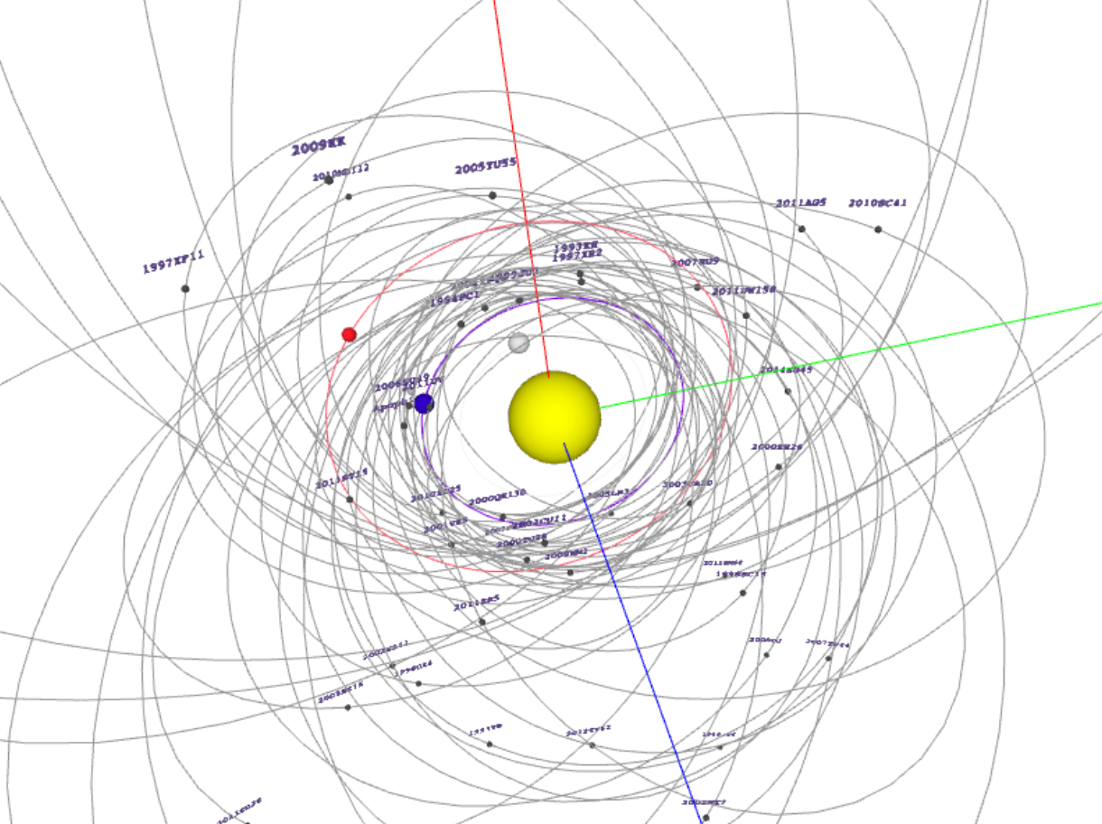
Visualization
Solar System Trajectories

Slide 6
Machine Learning
Logistic Regression
找出最有可能有流星（隕石）的區域

Slide 7
AWS Recognition
Face degree controller
判斷人臉角度來控制視角

Slide 8
Demo

Slide 9
Q&A

